Slide 1

PROJECT ON AP EDIFY
DEPARTMENT OF COMPUTER SCIENCE & ENGINEERING
PRESENTED BY
N. Deepa 124E1A0510
A. Reshma 124E1A0538

Slide 2
CONTENTS
Abstract
Existing System
Proposed System
Software requirements
Hardware requirements
System architecture
Modules

Slide 3
ABSTRACT
Now a days the need for higher education institutions to have a reliable, effective and attractive web presence is increasing as online technology is becoming an important part of the educational process.
This website is aimed to provide the efficient information about secondary and higher education colleges.

Slide 4
The higher education institutions play a vital role in the development of a society while higher education websites have many roles to fill.
In this website we show the list of Inter, engineering and degree colleges in AP, district wise .

Slide 5
EXISTING SYSTEM
In previous days to get information about colleges people need to search in different links which makes more complicated and time consumption.
Websites focuses on any one category of institutions like Inter/Degree/Engineering under one district.

Slide 6
DISADVANTAGES OF EXISTING SYSTEM
Time taking process.
All the information cannot be retrieved in one website.
Ambiguous.

Slide 7
PROPOSED SYSTEM
AP EDIFY focuses on only one link to provide different educational institutions information.
Information includes category wise details like colleges under particular universities of all the districts in AP.

Slide 8
ADVANTAGES OF PROPOSED SYSTEM
User friendly.
Time complexity is less.
We can gather any college information fastly.

Slide 9
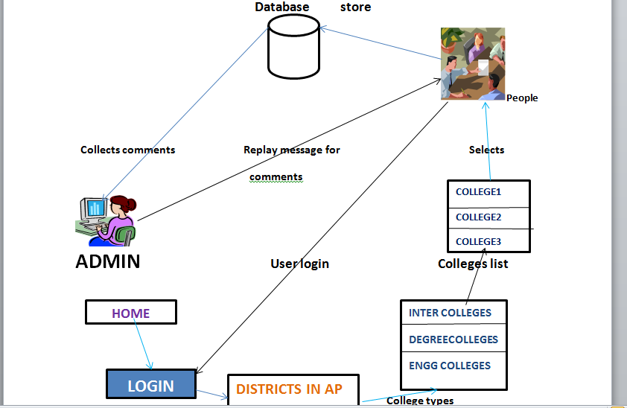
SYSTEM ARCHITECTURE

Slide 10
SYSTEM ARCHITECTURE
The architecture contains the main roles of the project and what is the process of working this project.
The colleges list provides the information about the colleges that which are implemented in district wise.
If the people want to send comments to admin,if they are not interested to send comments is not necessary.
The database stores the information of the comments.

Slide 11
MODULES
Home
Colleges list
User
Admin
Districts in AP

Slide 12
HOME
The home page which provides the basic details of my application which consist of all colleges information.
It provides the descriptive about all colleges.

Slide 13
COLLEGES LIST
In the second module ,college list provides the information about the secondary and higher education colleges .
In this colleges list,list out the colleges and we give some description by this people can easily know the information about the colleges.

Slide 14
USER
Basically there are stakeholders who have rights to know information about the colleges.
Students must have pre-registration into this website so authenticated users can become the member and they have the rights to post the comments.

Slide 15
ADMIN
The total rights and all the information can see by admin only.
The admin goes through check the comments that which is given by the users.

Slide 16
DISTRICTS IN AP
In this module ,districts list provides the information about the districts which are present in AP.
In this application secondary and higher education colleges are presented in district wise.

Slide 17
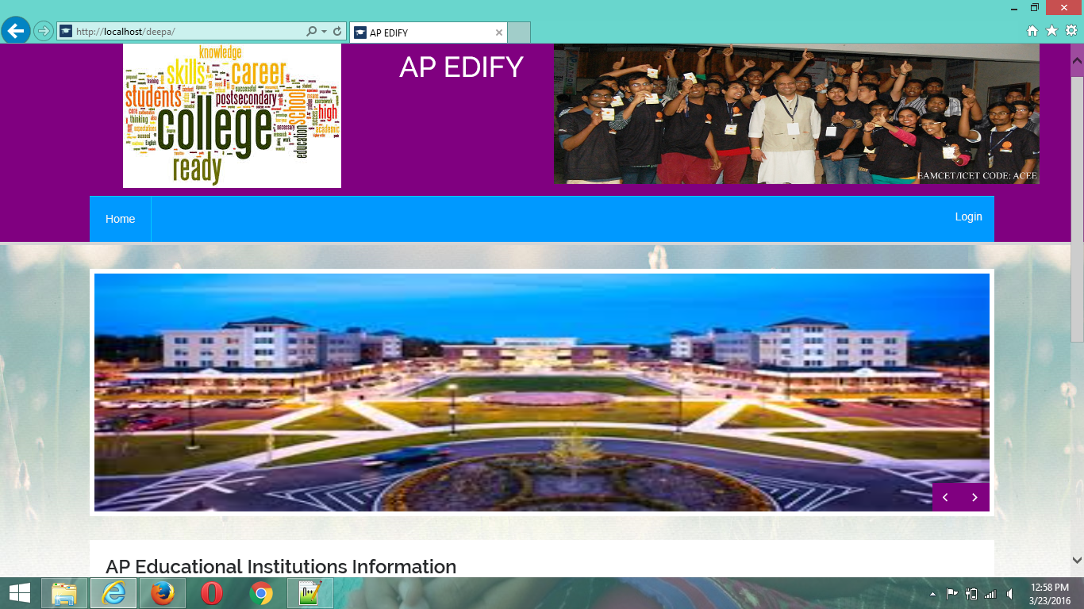
SCREEN SHOTS
The home page displays few information about AP EDIFY. Home page displays contact details.

Slide 18
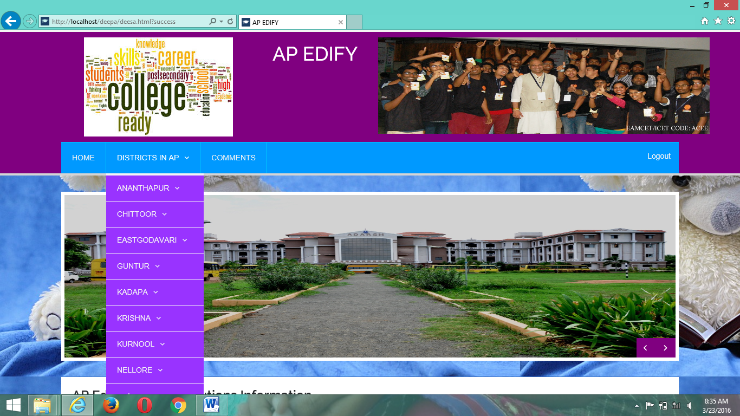
After successfully login information of the website will be visible. List of districts are represented in to this page.

Slide 19
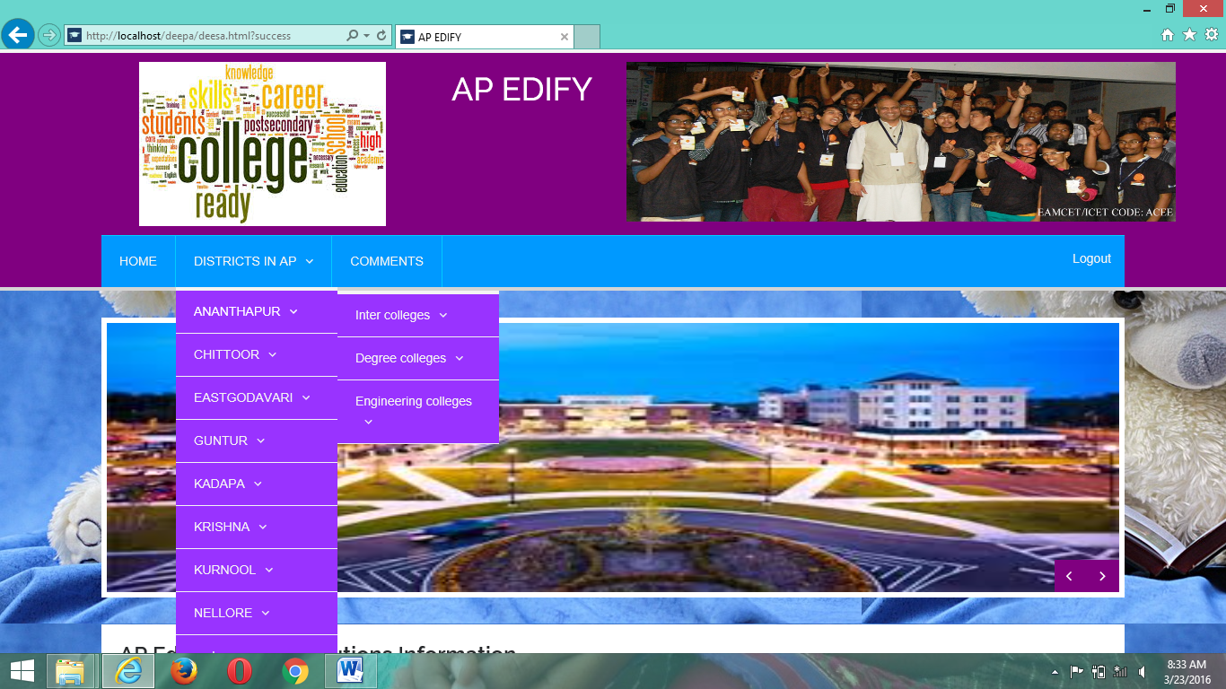
In this page list of colleges types are represented and select any one of college type to search colleges information in district wise.

Slide 20
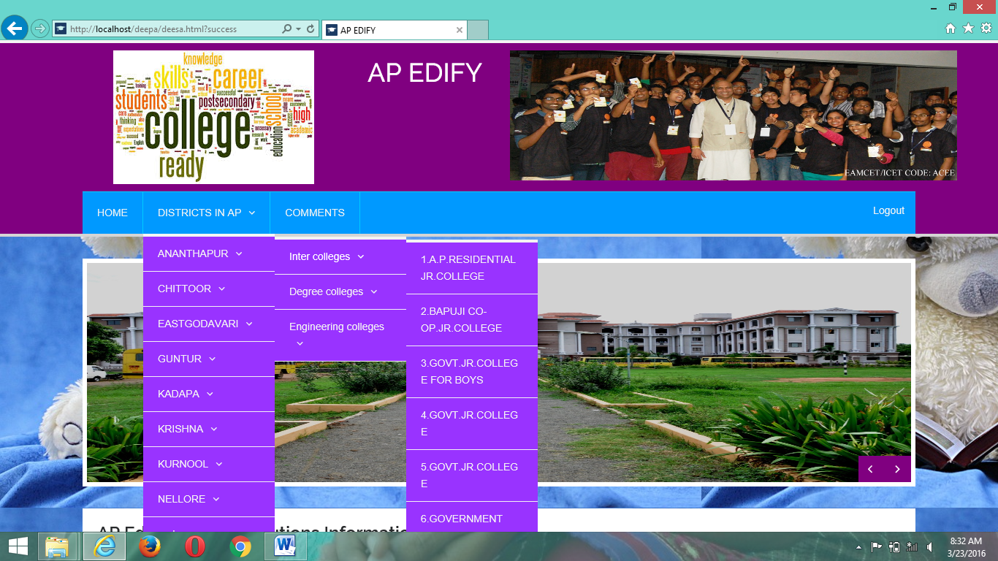
In this page list of colleges are visible and select any one college in list of colleges to search college information.

Slide 21
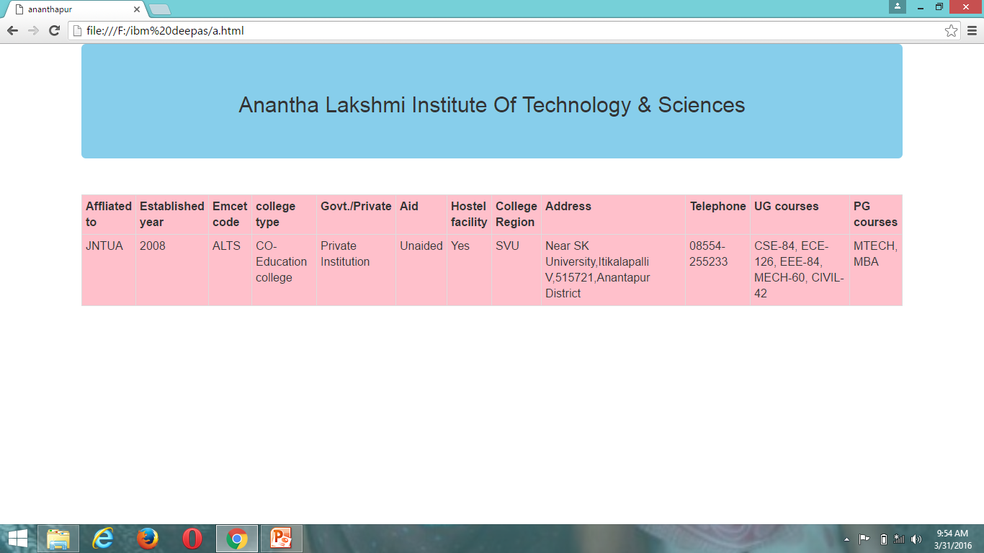
Output of the website.

Slide 22
CONCLUSION
There were a lot of difficulties for the users regarding the colleges that which are represented in AP.
All the colleges information is provided in this website.
Users are easy to know the information and less time taken by using AP EDIFY to search colleges.

Slide 23
THANK YOU

